Slide 1
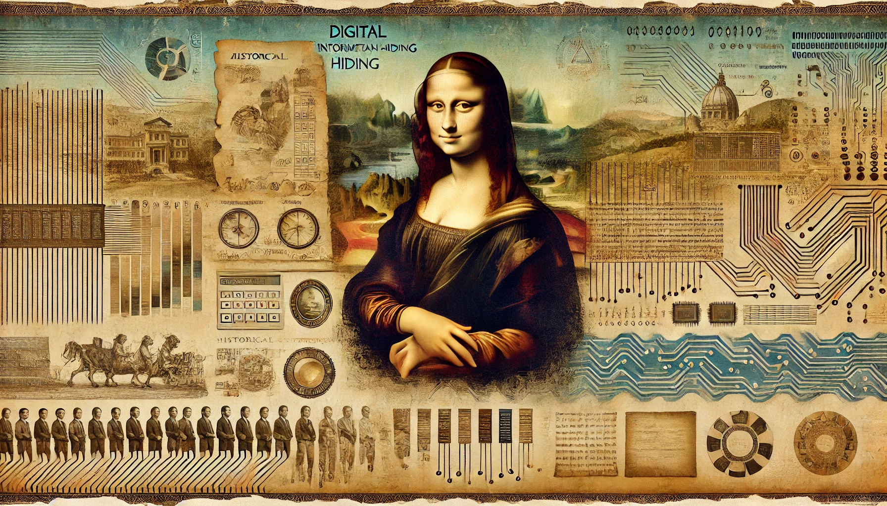
INFORMATION HIDING
Scalable Watermarking
Adib Nikjou, Shiraz University of Technology, Summer 2025

Slide 2
Introduction to Scalable Watermarking

Slide 3
Scalable compression
A significant problem with online access to content was the time required to download it, particularly if the content contained many images.
In the late 1970s and early 1980s, most modems were capable of transmission speeds of 1200 bits per second. At this speed, a single uncompressed 512 × 512 greyscale image at 8 bits per pixel could take half an hour to download.
Although each line of the image was displayed as soon as it was received, it could still be 15 minutes before the user had a reasonable idea what the final picture would be like.

Slide 4
Scalable compression
In 1979, Sloan and Tanimoto published their solution to this problem, which may be considered the first resolution scalable compression algorithm. They suggested that, rather than using line-by-line image transmission, a low-resolution approximation of the image could be sent first, and then successively refined until the complete image had been received.
The effect was dramatic. Using this approach, the main image features became visible very early in the transmission, so very little waiting was required to obtain a reasonable picture.

Slide 5
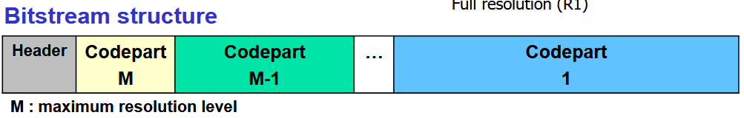

Scalable compression
Furthermore, if the quality was already acceptable, or the image was not what the user had hoped for, transmission could be stopped early, freeing up the bandwidth for other downloads. It was even possible to target a specific area of interest and only download the refinement data for that area.

Slide 6
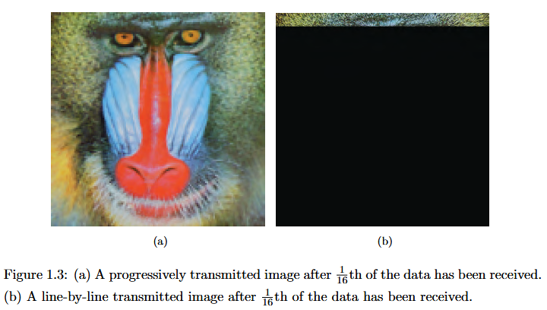

Scalable compression

Slide 7
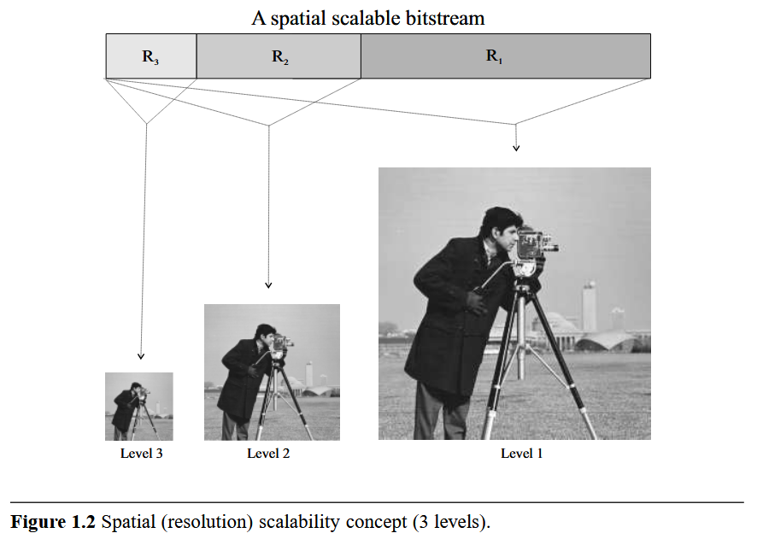
Scalable compression

Slide 8
Scalable compression
The first quality scalable compression algorithm was published five years later, in 1984, by Sanz, Mu˜noz and Garc´ıa. Before this point, each refinement layer defined by a scalable compression algorithm increased the spatial resolution of the image, but pixel quantization was the same at all refinement layers.
Sanz et al. recognized that not all users would require an unquantized image and that a similar, multi-level transmission method could be defined that used images quantized to different numbers of bits per pixel, rather than different spatial resolutions.

Slide 9
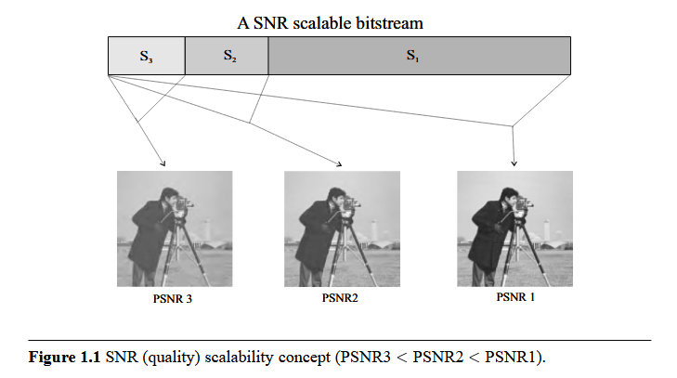
Scalable compression

Slide 10
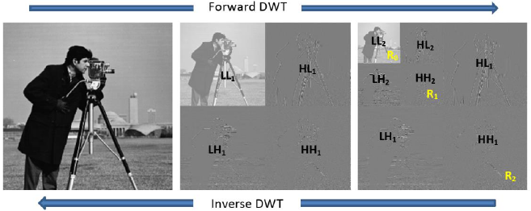
Scalable compression
They further suggested that these techniques could be combined, using either a fixed or an interactively defined sequence of resolution and quality improvements, foreshadowing compression algorithms with both resolution and quality scalability such as HS-SPIHT, JPEG2000 and EBCOT.

Slide 11
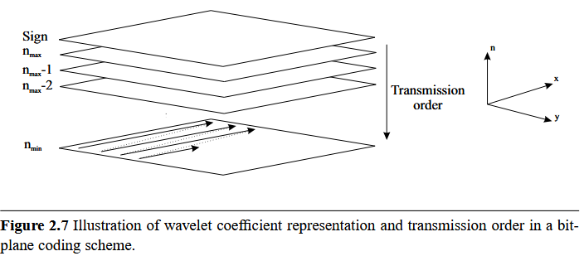
Scalable compression

Slide 12
Scalable compression
Despite a dramatic increase in achievable transmission speeds since the 1980s, the need for scalable compression has not diminished.
Not only this, but the range of devices being used to access the Internet has expanded, so while a typical mobile phone user may desire content suited to a display with 320 × 240 resolution, a high-end desktop user would prefer content tailored to a display resolution of 1900 × 1200.

Slide 13
Scalable compression
Although it is possible to satisfy all device and connection constraints by offering only highly compressed, low-resolution content, this would completely fail to meet the quality expectations of users with fast connections and/or high-resolution displays.
To cater for the widest possible range of users, it is necessary to provide access to content at different resolutions and levels of compression. This could, of course, be achieved using multiple separate copies of the content, at a range of resolutions and compression ratios.

Slide 14
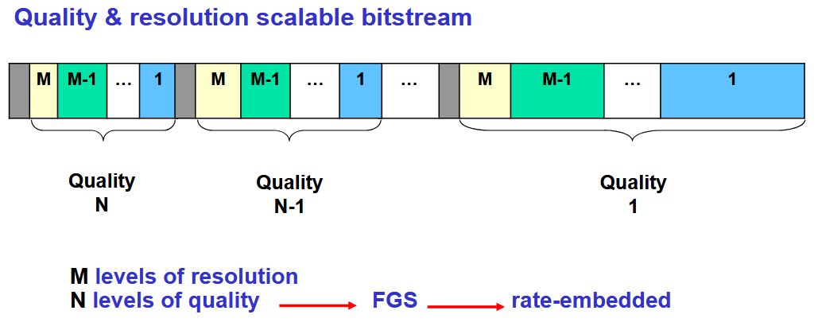
Scalable compression
However, scalable compression offers a superior solution, in that it only requires the creation and storage of one copy of the content and can adapt dynamically to changing network conditions or user demands.

Slide 15
Scalable watermarking
It is rarely effective to simply apply a traditional watermarking algorithm to scalably compressed content.
This because the scaling process, which tailors the content to suit the user’s requirements, involves discarding layers of content.
Any watermark data contained in those layers will have been lost.

Slide 16
An approach to Scalable watermarking
Firstly, the lowest acceptable resolution or quality is determined.
Secondly, the maximum level of scaling associated with the lowest acceptable resolution or quality is determined (content scaled beyond this level is considered no longer valuable and thus no longer in need of a watermark).
Finally, the watermark is embedded in the portions of the content that are largely unaffected by that level of scaling.

Slide 17
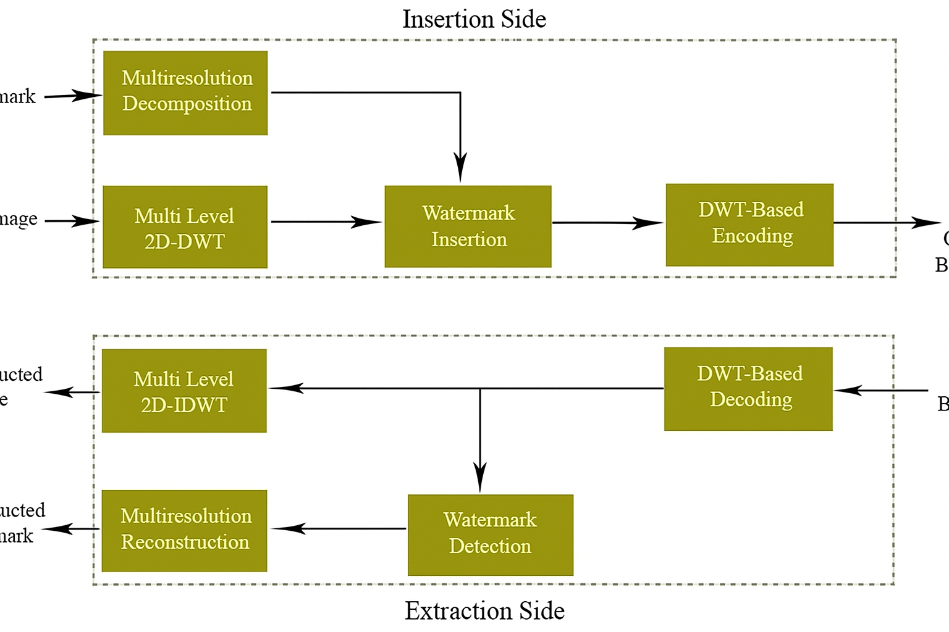








First approach to Scalable watermarking
Watermark
Host Image
Output Bitstream
Reconstructed Image
Input Bitstream
Reconstructed Watermark

Slide 18
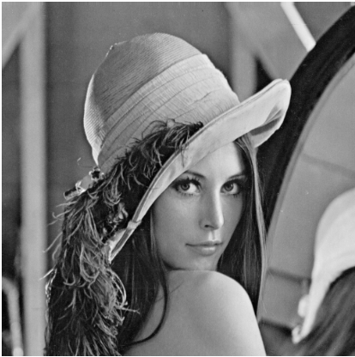
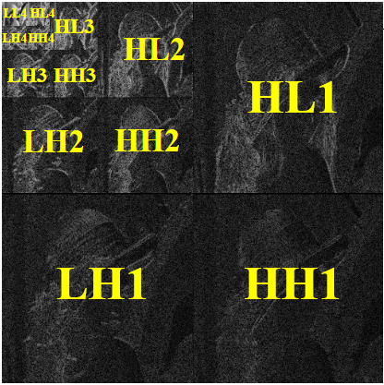
First approach to Scalable watermarking
Apply 5 levels of a 2D-DWT to the original image

Slide 19
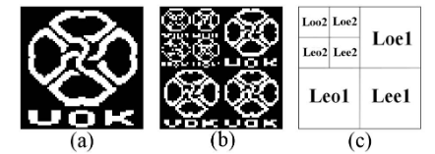
First approach to Scalable watermarking
Apply 2 levels of a 2D down-sampling to the binary watermark image
A 64x64 Binary Watermark

Slide 20
First approach to Scalable watermarking
Watermark
Transform Image
Loo2 Lee2
LL5 HL5
Leo1
HL4
Leo2 Lee2
LH5 HH5
Leo1 Lee1
LH4 HH4

Slide 21
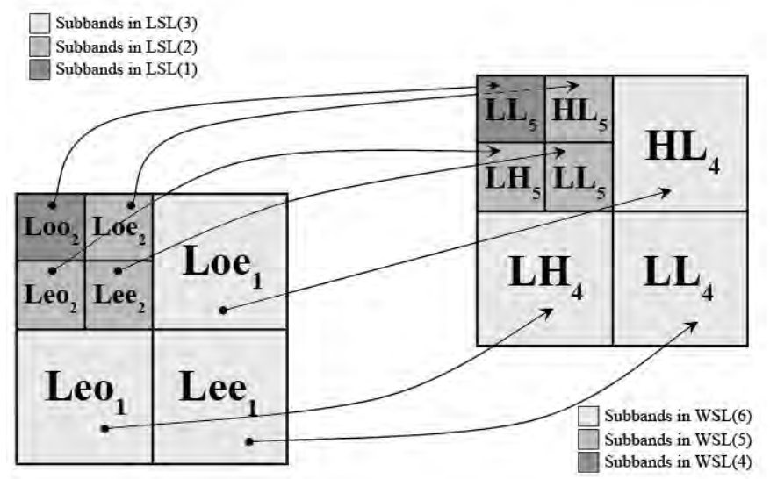
First approach to Scalable watermarking

Slide 22
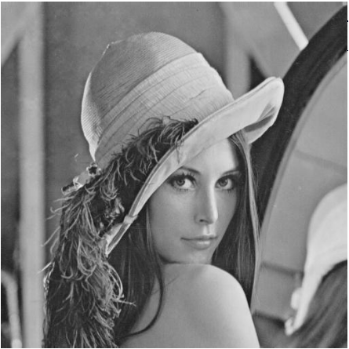
First approach to Scalable watermarking
Original Image
Watermarked Image
PSNR = 46.47 dB, JND = 166.6

Slide 23
First approach to Scalable watermarking
Watermark Detection
Apply 5 levels of a 2D-DWT to the decoded image
2) Extract each component of decomposed watermark from the corresponding sub-band of transformed image
3) Apply 2 levels of inverse 2D down-sampling to reconstruct binary watermark image

Slide 24
First approach to Scalable watermarking
Watermark Quality Measurement
To measure the quality of the reconstructed watermark we use DR:

Slide 25
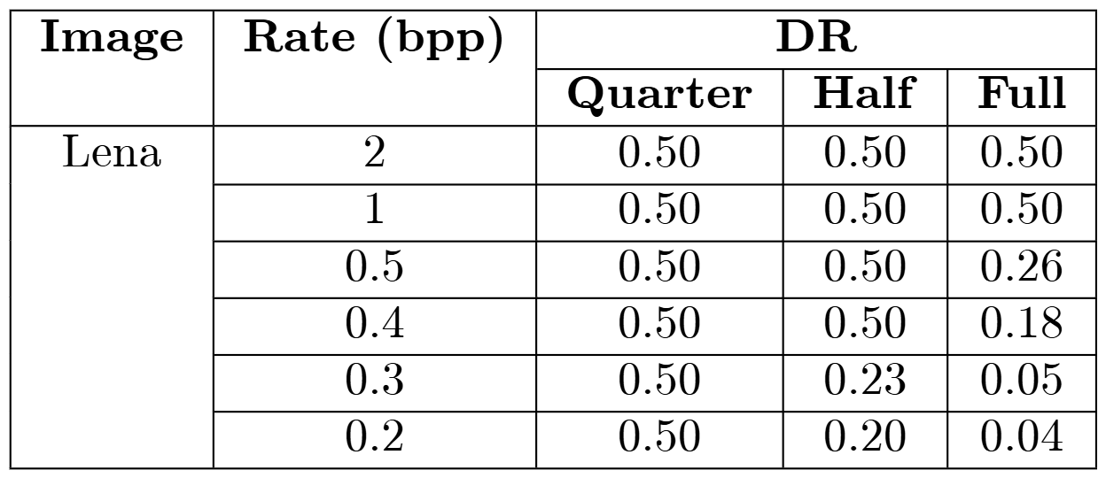
First approach to Scalable watermarking
Results for lossy decoding of the compressed watermarked images by SPIHT* at different bitrates

Slide 26


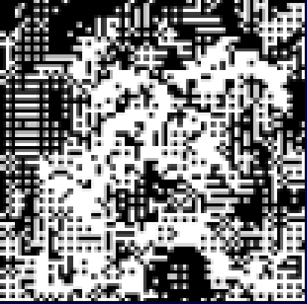
First approach to Scalable watermarking
Quarter resolution, DR = 0.50
Half resolution, DR = 0.50
Full resolution, DR = 0.30
Decoded watermarked image at bitrate = 0.4 bpp

Slide 27
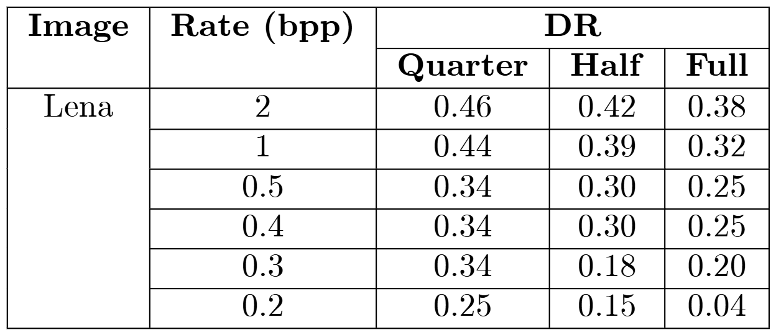
First approach to Scalable watermarking
Results for lossy decoding of the compressed watermarked images by JPEG2000 at different bitrates

Slide 28
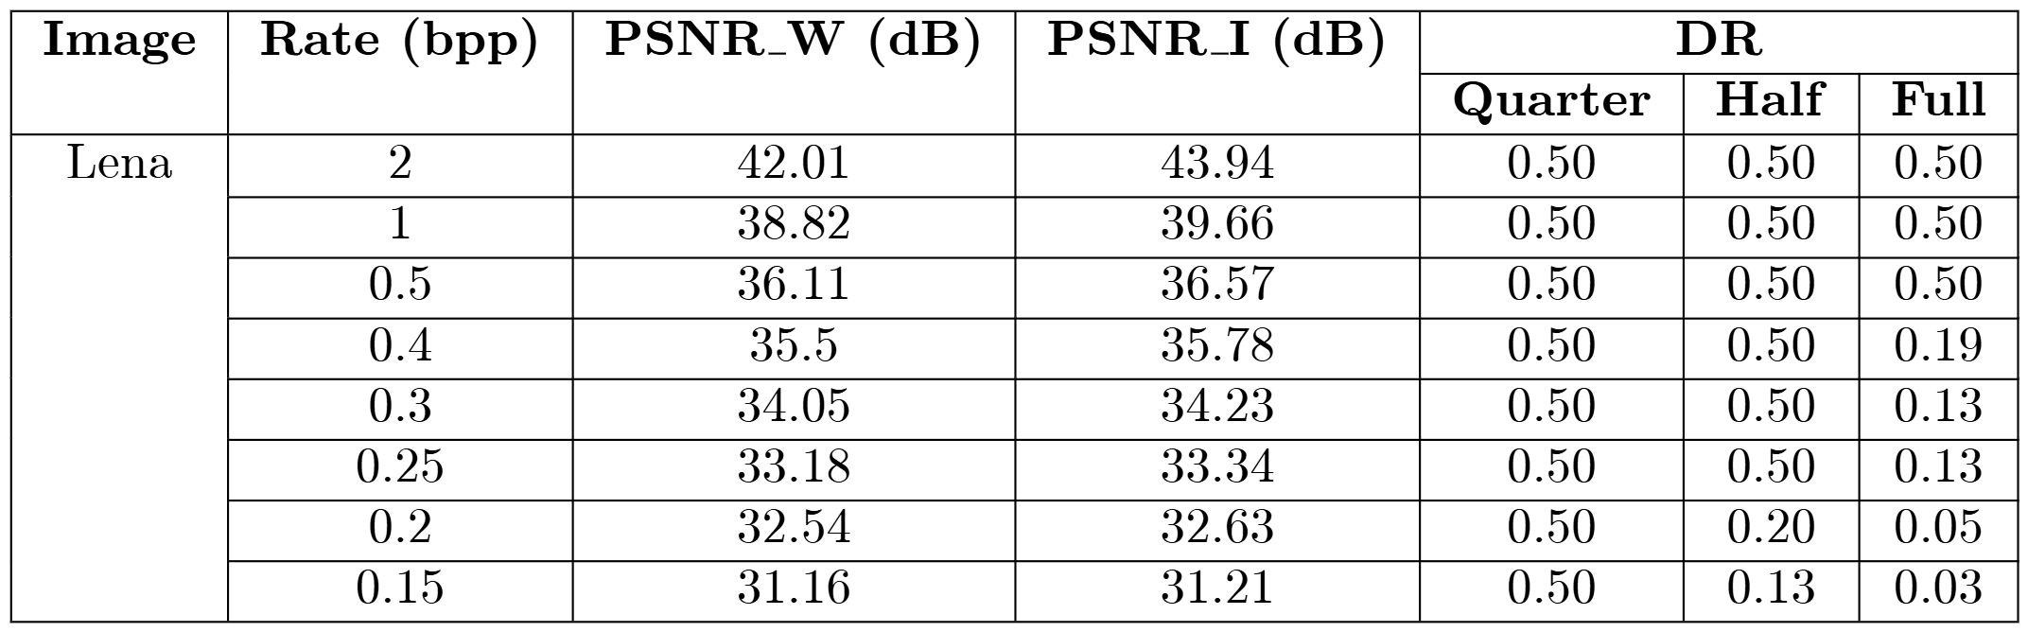
First approach to Scalable watermarking
Results for lossy decoding of the compressed watermarked images by HS-SPIHT at full resolution (512×512)

Slide 29
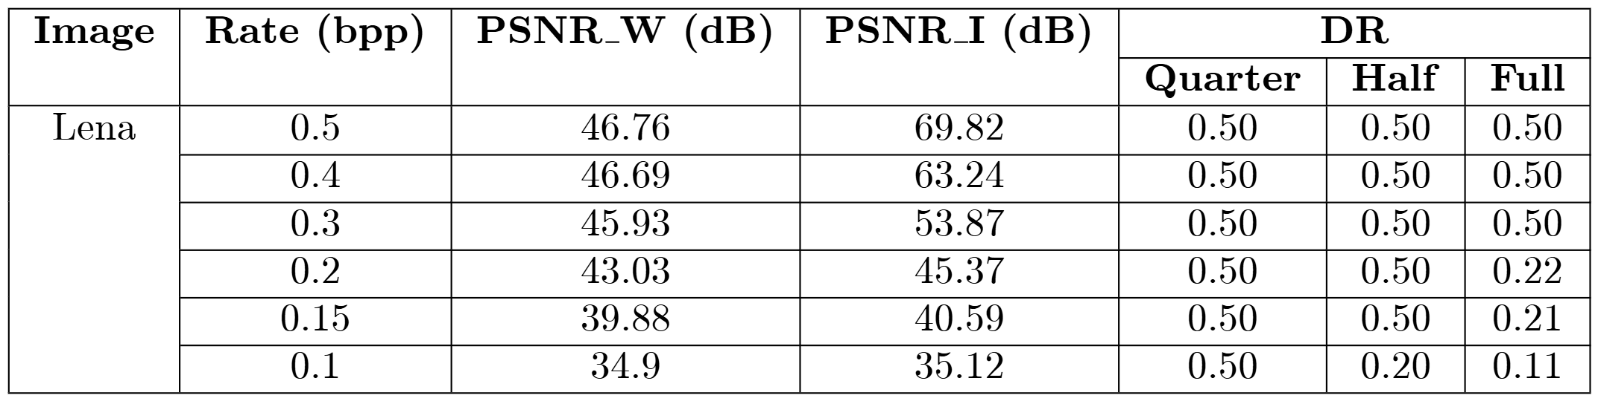
First approach to Scalable watermarking
Results for lossy decoding of the compressed watermarked images by HS-SPIHT at full resolution (128x128)

Slide 30
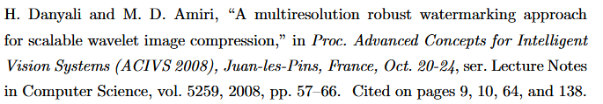

Second approach to Scalable watermarking

Slide 31
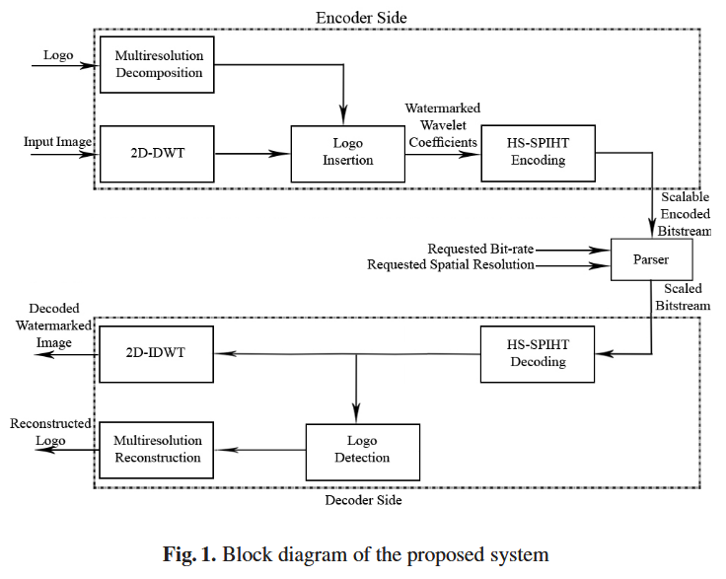


Slide 32
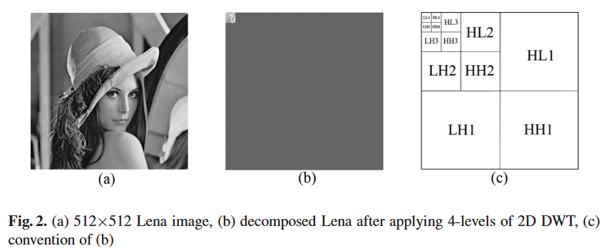
Second approach to Scalable watermarking

Slide 33
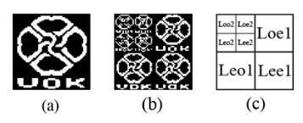
Second approach to Scalable watermarking

Slide 34
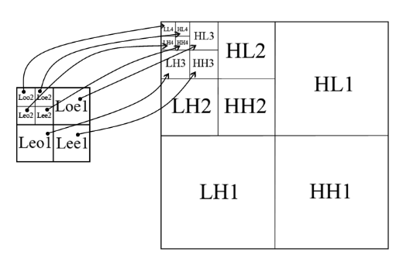
Second approach to Scalable watermarking

Slide 35
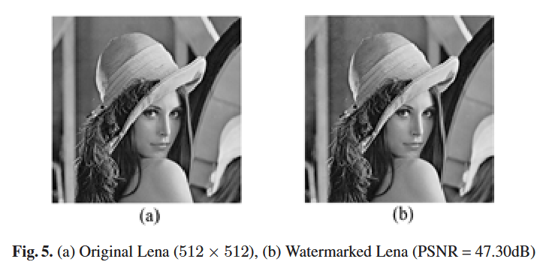
Second approach to Scalable watermarking

Slide 36
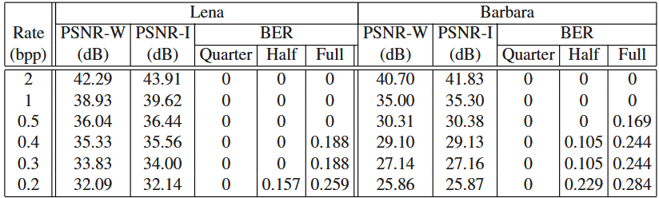
Second approach to Scalable watermarking

Slide 37
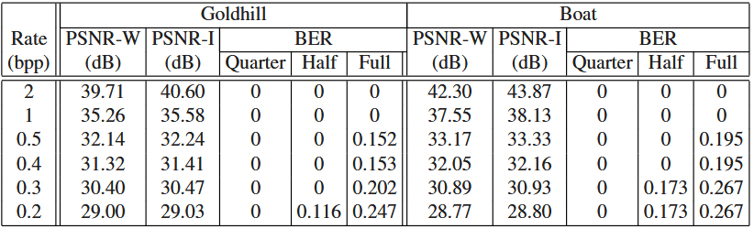
Second approach to Scalable watermarking

Slide 38
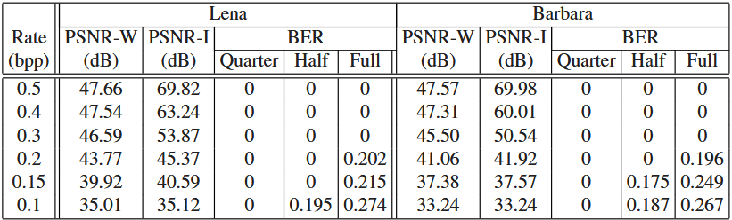
Second approach to Scalable watermarking

Slide 39
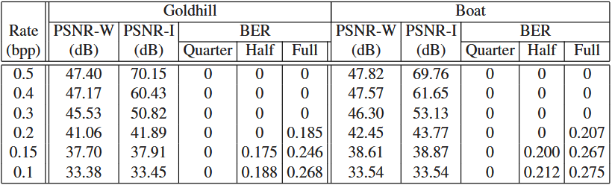
Second approach to Scalable watermarking

Slide 40
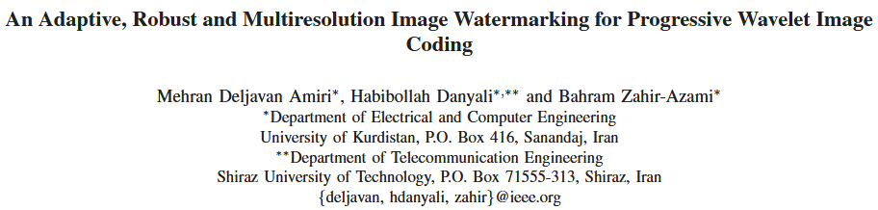
Third approach to Scalable watermarking
HERE WE ARE ADAPTIVLY SELECTING COEFFICIENTS !
M. D. Amiri, H. Danyali and B. Zahir-Azami, "An Adaptive, Robust and Multiresolution Image Watermarking for Progressive Wavelet Image Coding," 2010 6th International Conference on Wireless Communications Networking and Mobile Computing (WiCOM), Chengdu, China, 2010, pp. 1-4,
doi: 10.1109/WICOM.2010.5600629.

Slide 41
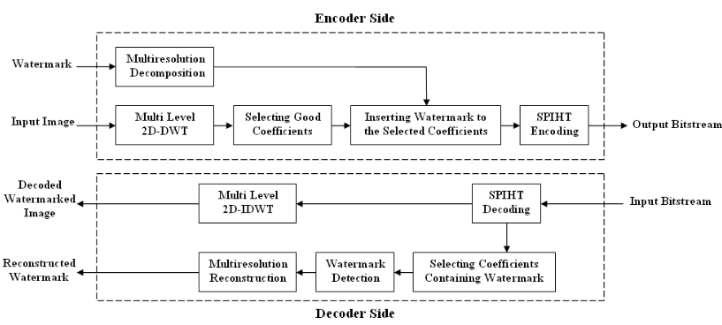
Third approach to Scalable watermarking

Slide 42
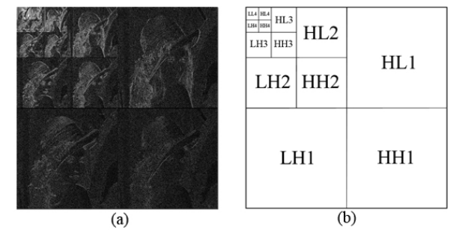
Third approach to Scalable watermarking

Slide 43
Third approach to Scalable watermarking

Slide 44
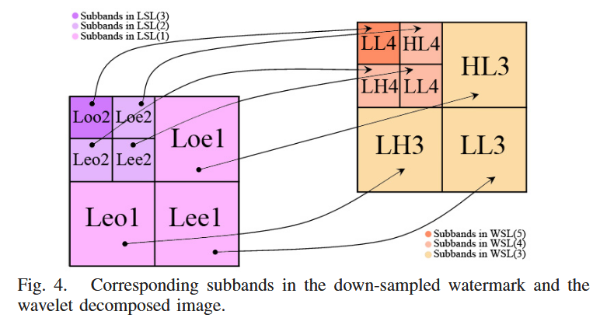
Third approach to Scalable watermarking

Slide 45
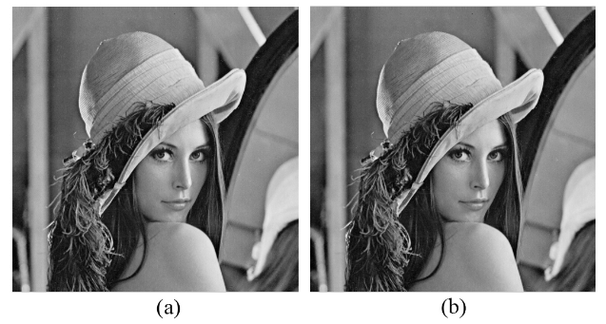

Third approach to Scalable watermarking

Slide 46
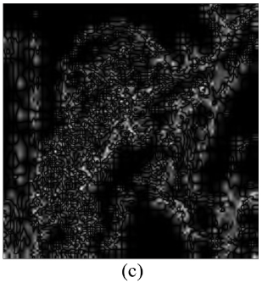
Third approach to Scalable watermarking
(c) Difference between original Lena and watermarked Lena (histogram equalized)

Slide 47
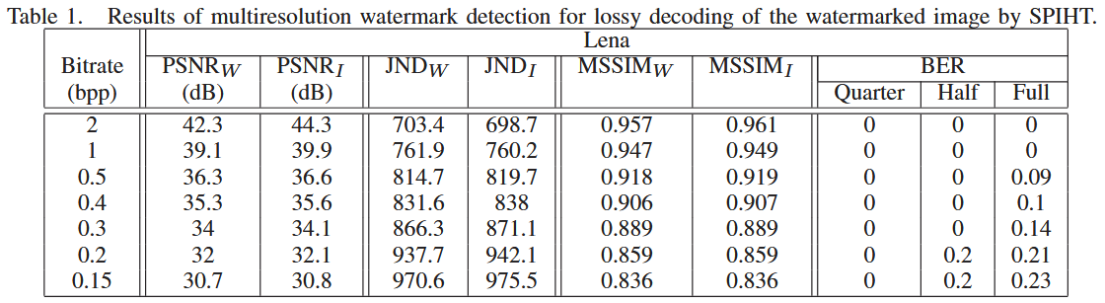
Third approach to Scalable watermarking

Slide 48
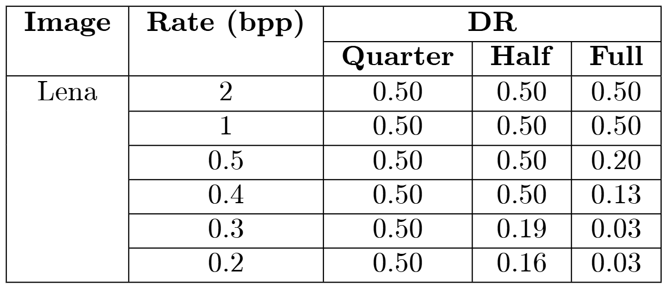
Third approach to Scalable watermarking
Results for lossy decoding of the compressed watermark images by SPIHT at different bitrates

Slide 49
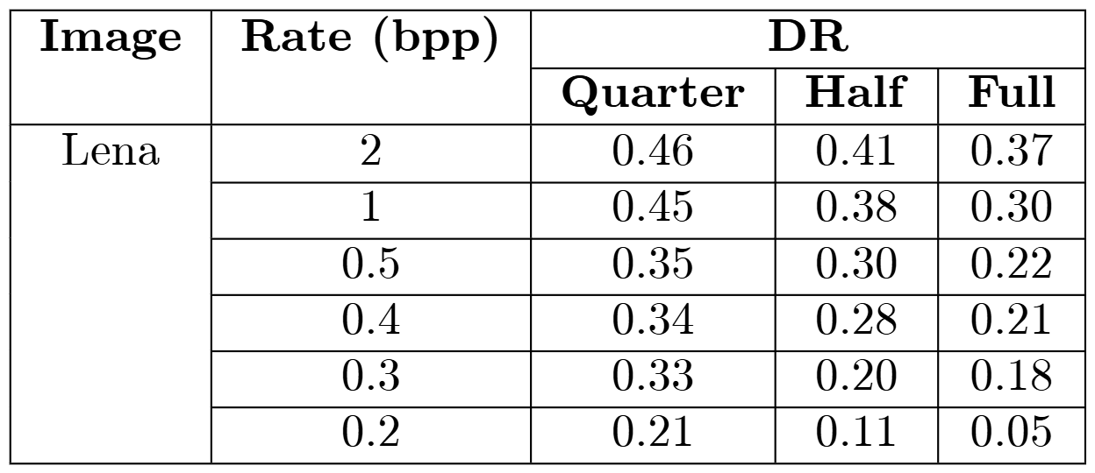
Third approach to Scalable watermarking
Results for lossy decoding of the compressed watermarked images by JPEG2000 at different bitrates

Slide 50
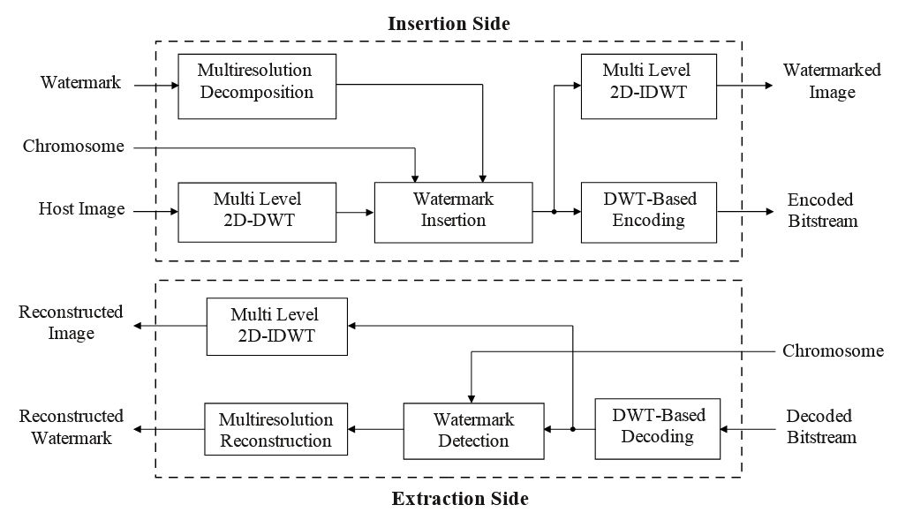
Fourth approach to Scalable watermarking

Slide 51
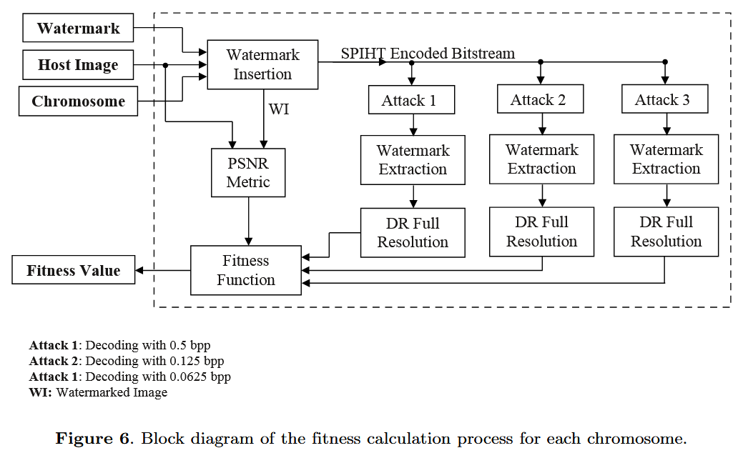

Fourth approach to Scalable watermarking

Slide 52
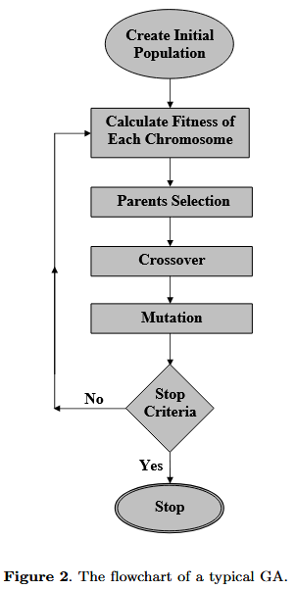
Fourth approach to Scalable watermarking
Genetic Algorithms (GA) Introduced by John Holland in 1975
• Global search methods based on Darwin’s “survival of the fittest”
• Candidate solutions are represented by chromosomes
• To compare chromosomes, a fitness function is needed
• To find a nearly optimum solution, an evolution process is performed on a population of chromosomes

Slide 53
Fourth approach to Scalable watermarking
• Fitter chromosomes have the greater chance to be selected and survive.
• The offsprings are generated by using genetic operations
➢ Crossover
➢ Mutation

Slide 54

Fourth approach to Scalable watermarking
First step to use GAs is to define the structure of the chromosomes
The first two genes of the chromosome (X1 , X0 ) are used to determine a position in the top-left coefficient of the lowest frequency sub band.

Slide 55
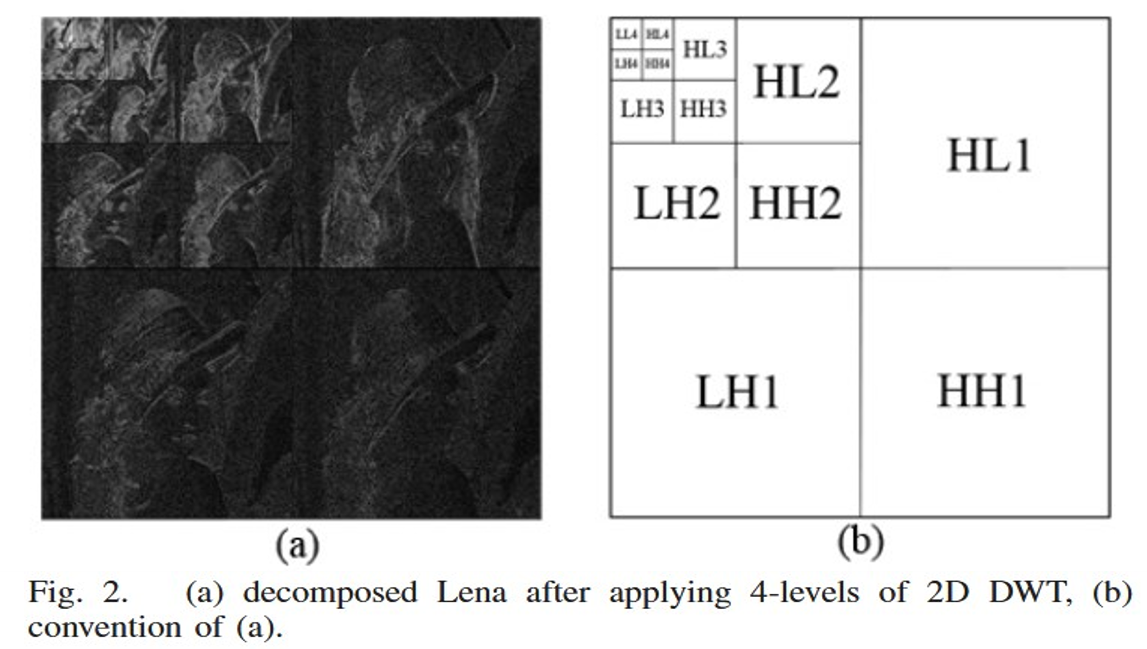
Fourth approach to Scalable watermarking

Slide 56
Fourth approach to Scalable watermarking

Slide 57
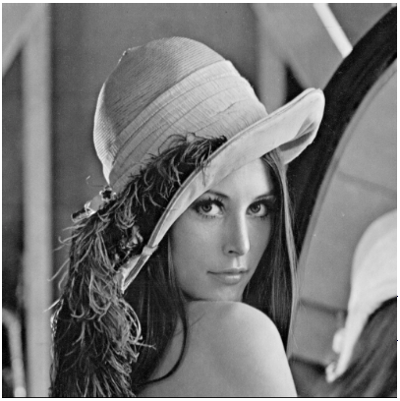
Fourth approach to Scalable watermarking
Original Image
Watermarked Image
PSNR = 48.62 dB, JND = 90.03

Slide 58
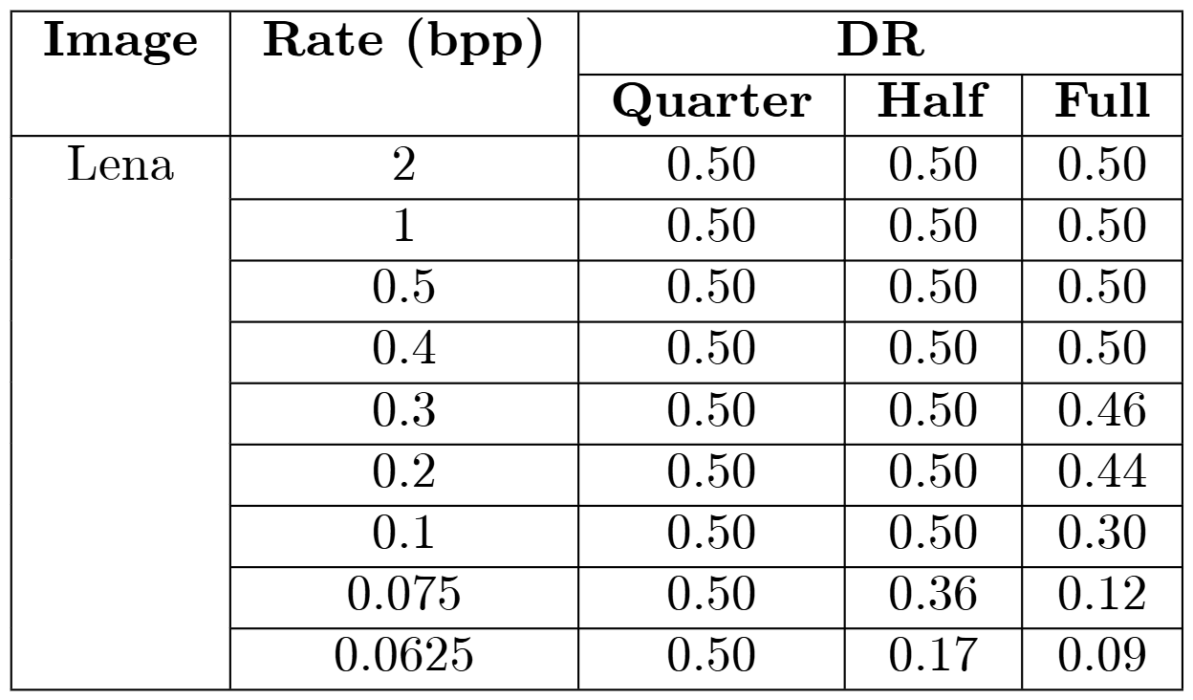
Fourth approach to Scalable watermarking
Results for lossy decoding of the compressed watermark images by SPIHT at different bitrates

Slide 59
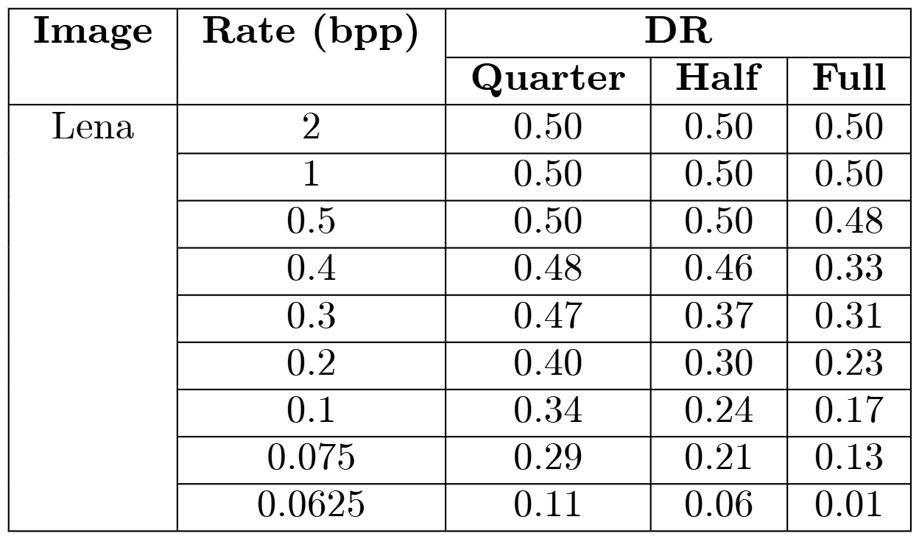
Fourth approach to Scalable watermarking
Results for lossy decoding of the compressed watermarked images by JPEG2000 at different bitrates

Slide 60
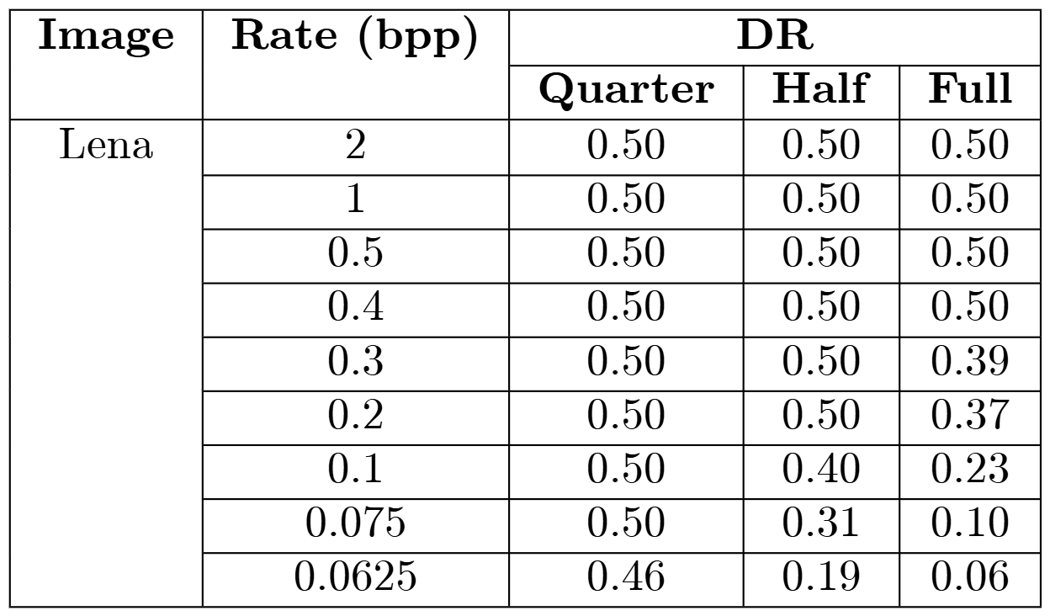
fourth approach to Scalable watermarking
Results for lossy decoding of the compressed watermarked images by HS-SPIHT at full resolution (512x512)

Slide 61
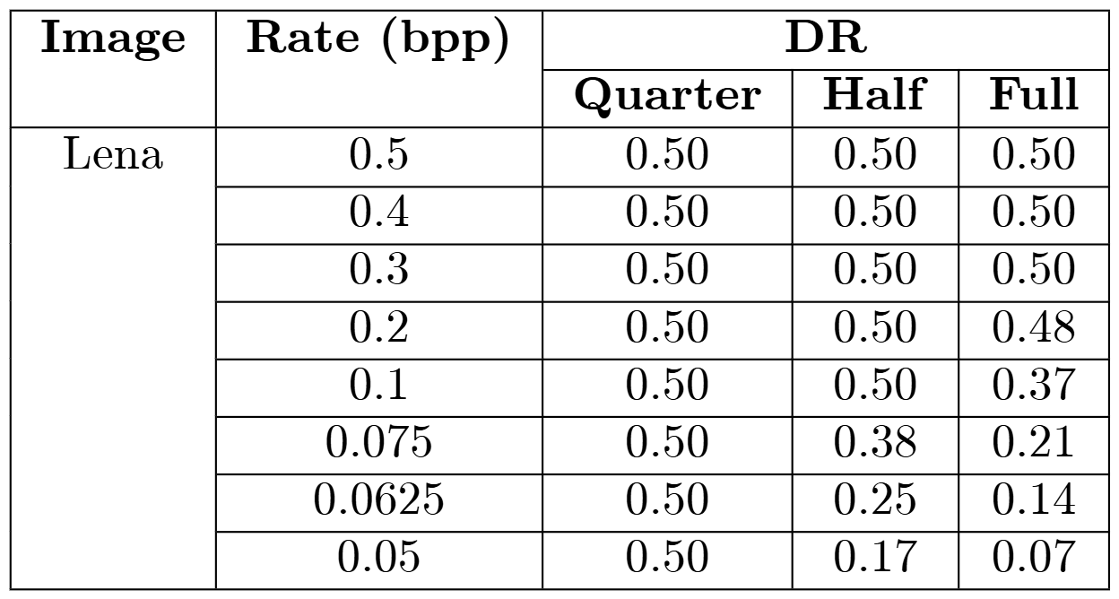
FOURTH approach to Scalable watermarking
Results for lossy decoding of the compressed watermarked images by HS-SPIHT at full resolution (128×128)

Slide 62
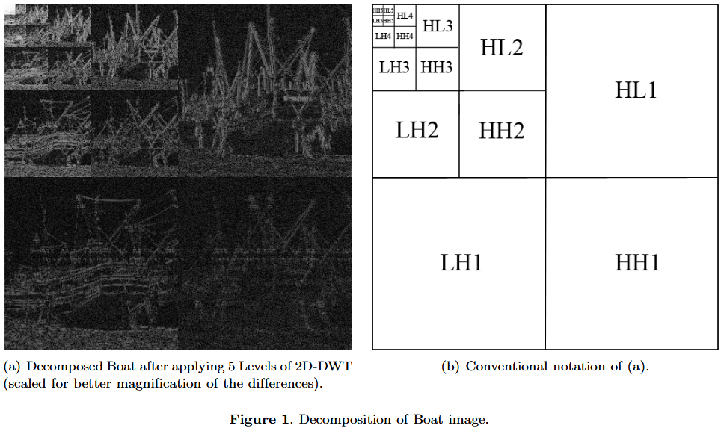
FOURTH approach to Scalable watermarking

Slide 63
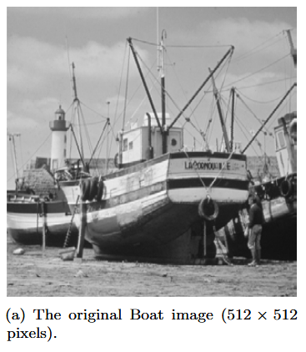
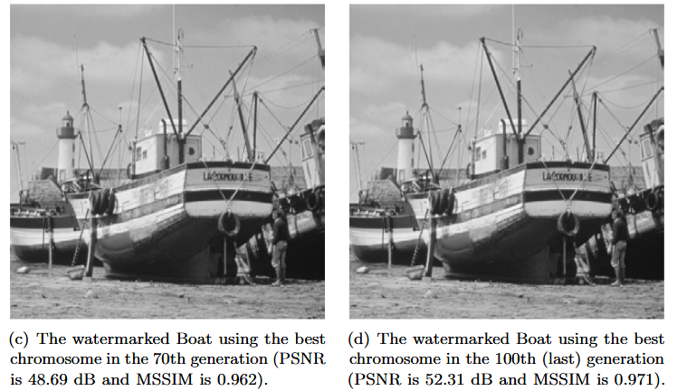
FOURTH approach to Scalable watermarking

Slide 64


FOURTH approach to Scalable watermarking

Slide 65


FOURTH approach to Scalable watermarking

Slide 66

FOURTH approach to Scalable watermarking

Slide 67

FOURTH approach to Scalable watermarking

Slide 68

FOURTH approach to Scalable watermarking

Slide 69

Comparison between 4 approaches

Slide 70

Comparison between 4 approaches

